Slide 1
Python Programming
CSE3011
LP
C - 3
Introduction to Python
Ashok Kumar Patel

Slide 2

Course objectives
To study object oriented paradigm in Python.
To develop their skill set using Python.
To familiarize with the functionalities and applications of Python.
Course outcomes
Keywords
Understand and use the Object Oriented paradigm in Python
Use the IO model in Python to read and write disk files.
Write Python programs using collections, regular expression, classifying and categorizing text.
Data Type, operators, control flow, tuples, set, dictionaries,OOPs, Classes, objects, Open Database Connectivity (ODBC), Postgres, MySQL, GUI, tkinter, Client Server programing, HTML, Common Gateway Interface (CGI)
Keywords

Slide 3
Syllabus
Introduction to Python
A Brief History of Python, Different Versions, Python 2 vs Python 3, Installing Python, Environment Variables, Executing Python from the Command Line, Editing Python Files, Basic Python Syntax, String Values, String Operators, Numeric Data Types Conversions, Simple Input and Output, Language components - Control Flow structures and Syntax – Relational Operators - Logical Operators - Bit Wise Operators, Python for Windows
Types and Operation
Keywords
Conditions, boolean logic, logical operators, ranges, Control statements: if-else, loops (for, while), Flow control, Functions,
Scoping, Exceptions, Input and output, Modules, Collections, Lists, Tuples, Sets, Dictionaries, Modules, Standard Modules,
Regular Expressions, Quantifiers, Basic String Operations
Classes and OOP
Principles of Object Orientation, Classes in Python, Creating Classes, Instance Methods, Access Specification, data modeling, persistent storage of objects, inheritance, polymorphism, operator overloading, abstract classes, exception handling, try block
Keywords

Slide 4
Syllabus
File Handling and Database Programming
File Handling, Writing Data to a File, Reading Data From a File -Additional File Methods: Using Pipes as Data Streams, Handling IO Exceptions, Working with Directories, Metadata, File Organization, Database Programming - Generic Database
Connectivity using ODBC, Postgres connection in Python, MySQL connection in Python.
GUI and Internet Programming
Keywords
Graphical user interfaces, event-driven programming paradigm, tkinter module, creating simple GUI, buttons, labels, entry fields, dialogs, widget attributes - sizes, fonts, colors layouts, nested frames, Multithreading, Networks, and Client/Server
Programming, introduction to HTML, interacting with remote HTML server, running html-based queries, downloading pages; CGI programming, programming a simple CGI form.
File Handling a
Keywords

Slide 5
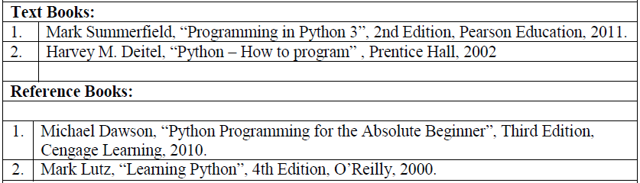
Books

Slide 6
Evaluation
Item / Type of Course | Marks/Weightage
Mid-Term Examination (50 marks) | 30
TEE (100 marks) | 30
Attendance | 5
Class Assessment | -
Assignments | -
Lab Assessment | 35
Total Marks | 100
Attendance % Range | Attendance Marks
Below 75% | 0
75 -80% | 1
81-85% | 2
86-90% | 3
91-95% | 4
96-100% | 5
TEE Marks (out of 100) ≥ 40
AND
Mid-Term (out of 50) + TEE (Out of 100) ≥ 60 (out of 150)
Minimum % Attendance required: 75% for Mid Term/TEE
From the date of registration into the course to one day before the start of Mid Term/Last Instructional Day

Slide 7
Evaluation
Continuous Assessment (20 Marks) | Challenging Task (15Marks)
One assessment from each experiment 20 marks per experiments Average marks to be taken | The final assessment for the lab component Last Session of the semester

Slide 8
Evaluation
Letter Grade | Grade Point | Remarks
S | 10 | Pass in the Course | Performance Grades
A | 9 | Pass in the Course
B | 8 | Pass in the Course
C | 7 | Pass in the Course
D | 6 | Pass in the Course
E | 5 | Pass in the Course
F | 0 | Failed in the course by not securing the minimum total marks required (TEE Marks < 40% OR (Mid-Term+ TEE < 40%))
N | 0 | Absent for TEE / Malpractice in Examinations / Acts of indiscipline/ Debarred from writing TEE
P | - | Passed in a ‘Pass-Fail’ course

Slide 9
Python Programming
CSE3011
LP
C - 3
Introduction to Python
Ashok Kumar Patel

Slide 10
Introduction to Python
Introduction to Python
What is Python?
Python is a Programming language which is Object-oriented, High-level, Interpreted, Multi-Purpose and Extremely user friendly.

Slide 11
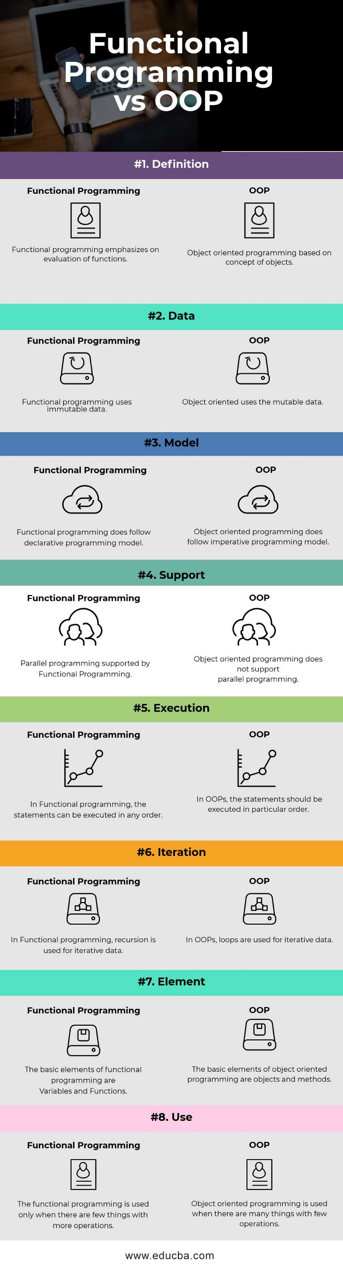
Introduction to Python
Introduction to Python

Slide 12
Introduction to Python
Introduction to Python

Slide 13
Introduction to Python
Introduction to Python

Slide 14
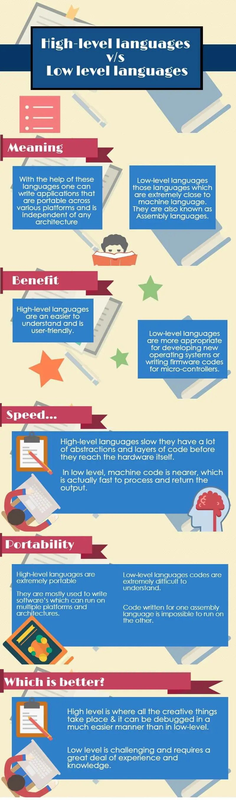
Introduction to Python
Introduction to Python

Slide 15
Introduction to Python
Introduction to Python

Slide 16
Introduction to Python
Introduction to Python

Slide 17
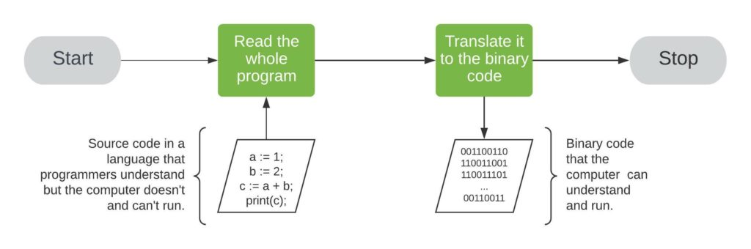
Introduction to Python
Introduction to Python
Computers cannot run the code written in a high–level language. We first have to translate it into binary code. To do so, we use compilers and interpreters.
Compilers take a whole program as input and translate it to an executable binary code in several steps.
We can run the binary code only on the machine on which we compiled it. That’s because the binary code depends on the hardware and is not portable.
https://www.baeldung.com/cs/compiled-vs-interpreted-languages

Slide 18
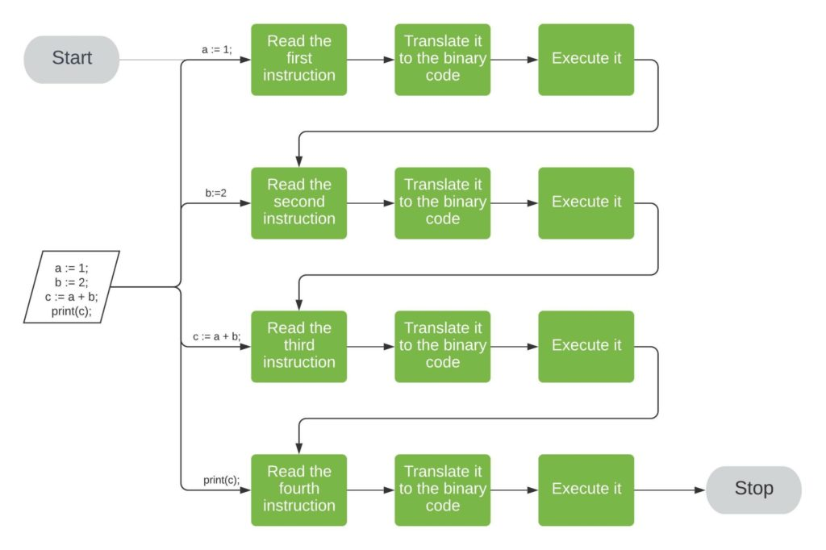
Introduction to Python
Introduction to Python
Computers cannot run the code written in a high–level language. We first have to translate it into binary code. To do so, we use compilers and interpreters.
Interpreters read and execute the program at hand instruction by instruction. After being read, each instruction is translated into the machine’s binary code and run.
Unlike compilers, the interpreters do not produce a binary executable file. Each time we run a program, we invoke the interpreter. It then reads and executes the program one instruction at a time
https://www.baeldung.com/cs/compiled-vs-interpreted-languages

Slide 19
Introduction to Python
Introduction to Python
History in Brief:
Invented in the Netherlands by Guido Van Rossum
Python was coined and conceived in the late 1980s
Implementation was started in December 1989
Named after Monty Python
Guido Van Rossum(the founder) was a fan of Monty Python’s ‘Flying Circus’ – a famous TV show in the Netherlands then.

Slide 20
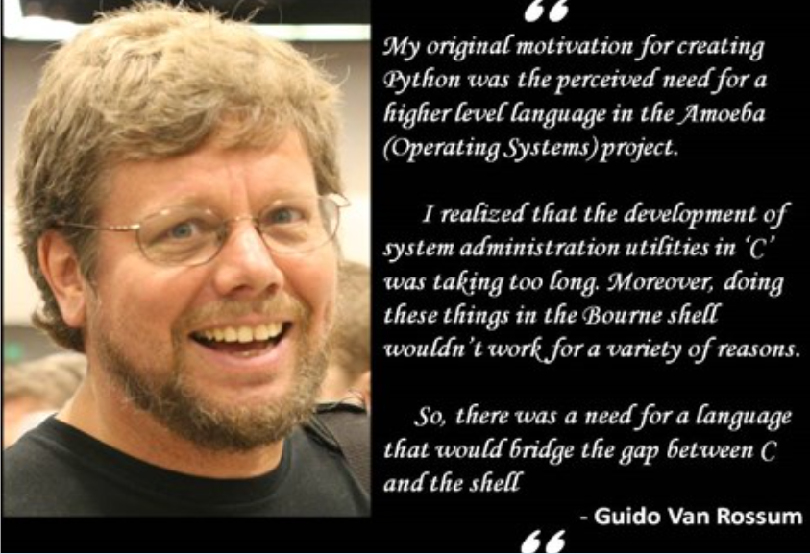
Introduction to Python
Introduction to Python
History in Brief:

Slide 21
Introduction to Python
Introduction to Python
Why learn Python?
Python has a simple syntax; it has abundant libraries and built-in-modules when compared to many other high-level languages like C, C++, Java etc.
Portable - Python is a cross-platform language i.e. the code written in one operating system, say windows, will work well with other operating systems like Mac OS or Linux.
It is Easy to use
Python does a different kind of tasks on varied platforms.

Slide 22
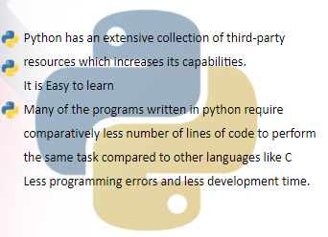
Introduction to Python
Introduction to Python
Why learn Python?
https://www.powershow.com/view0/8a8ef4-NTQ3M/Overview_of_Python_History_Advantages_Applications_IQOnlineTraining_powerpoint_ppt_presentation

Slide 23
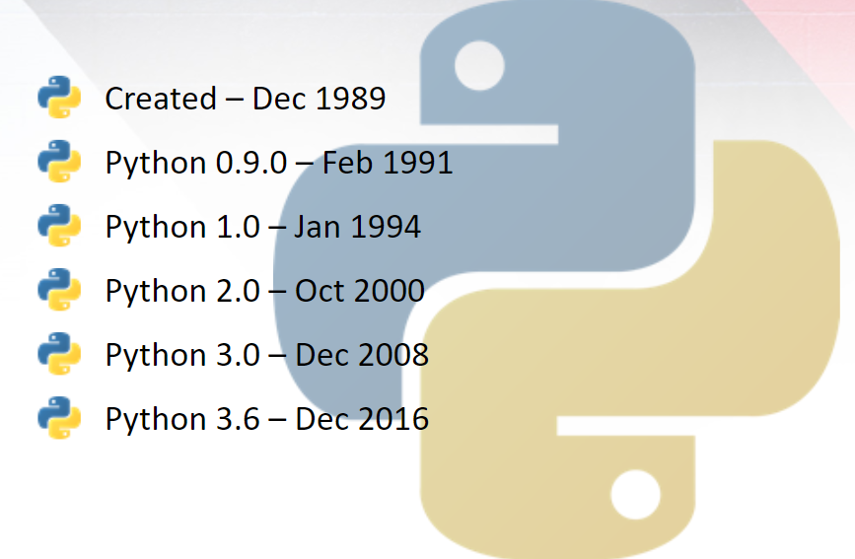
Introduction to Python
Introduction to Python
Major Releases:

Slide 24
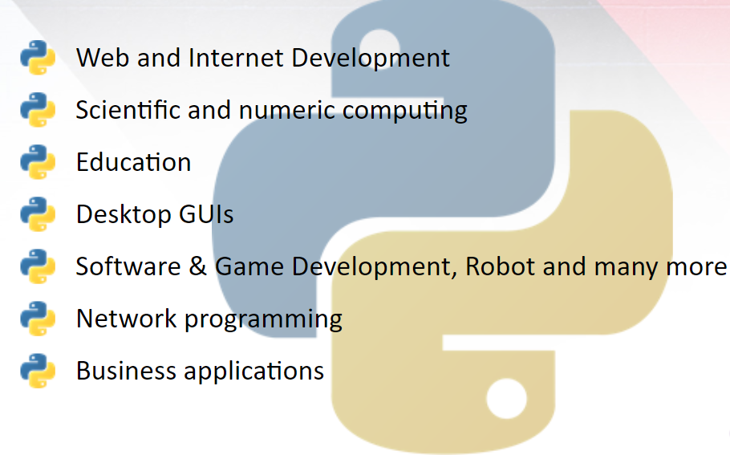
Introduction to Python
Introduction to Python
Applications:

Slide 25
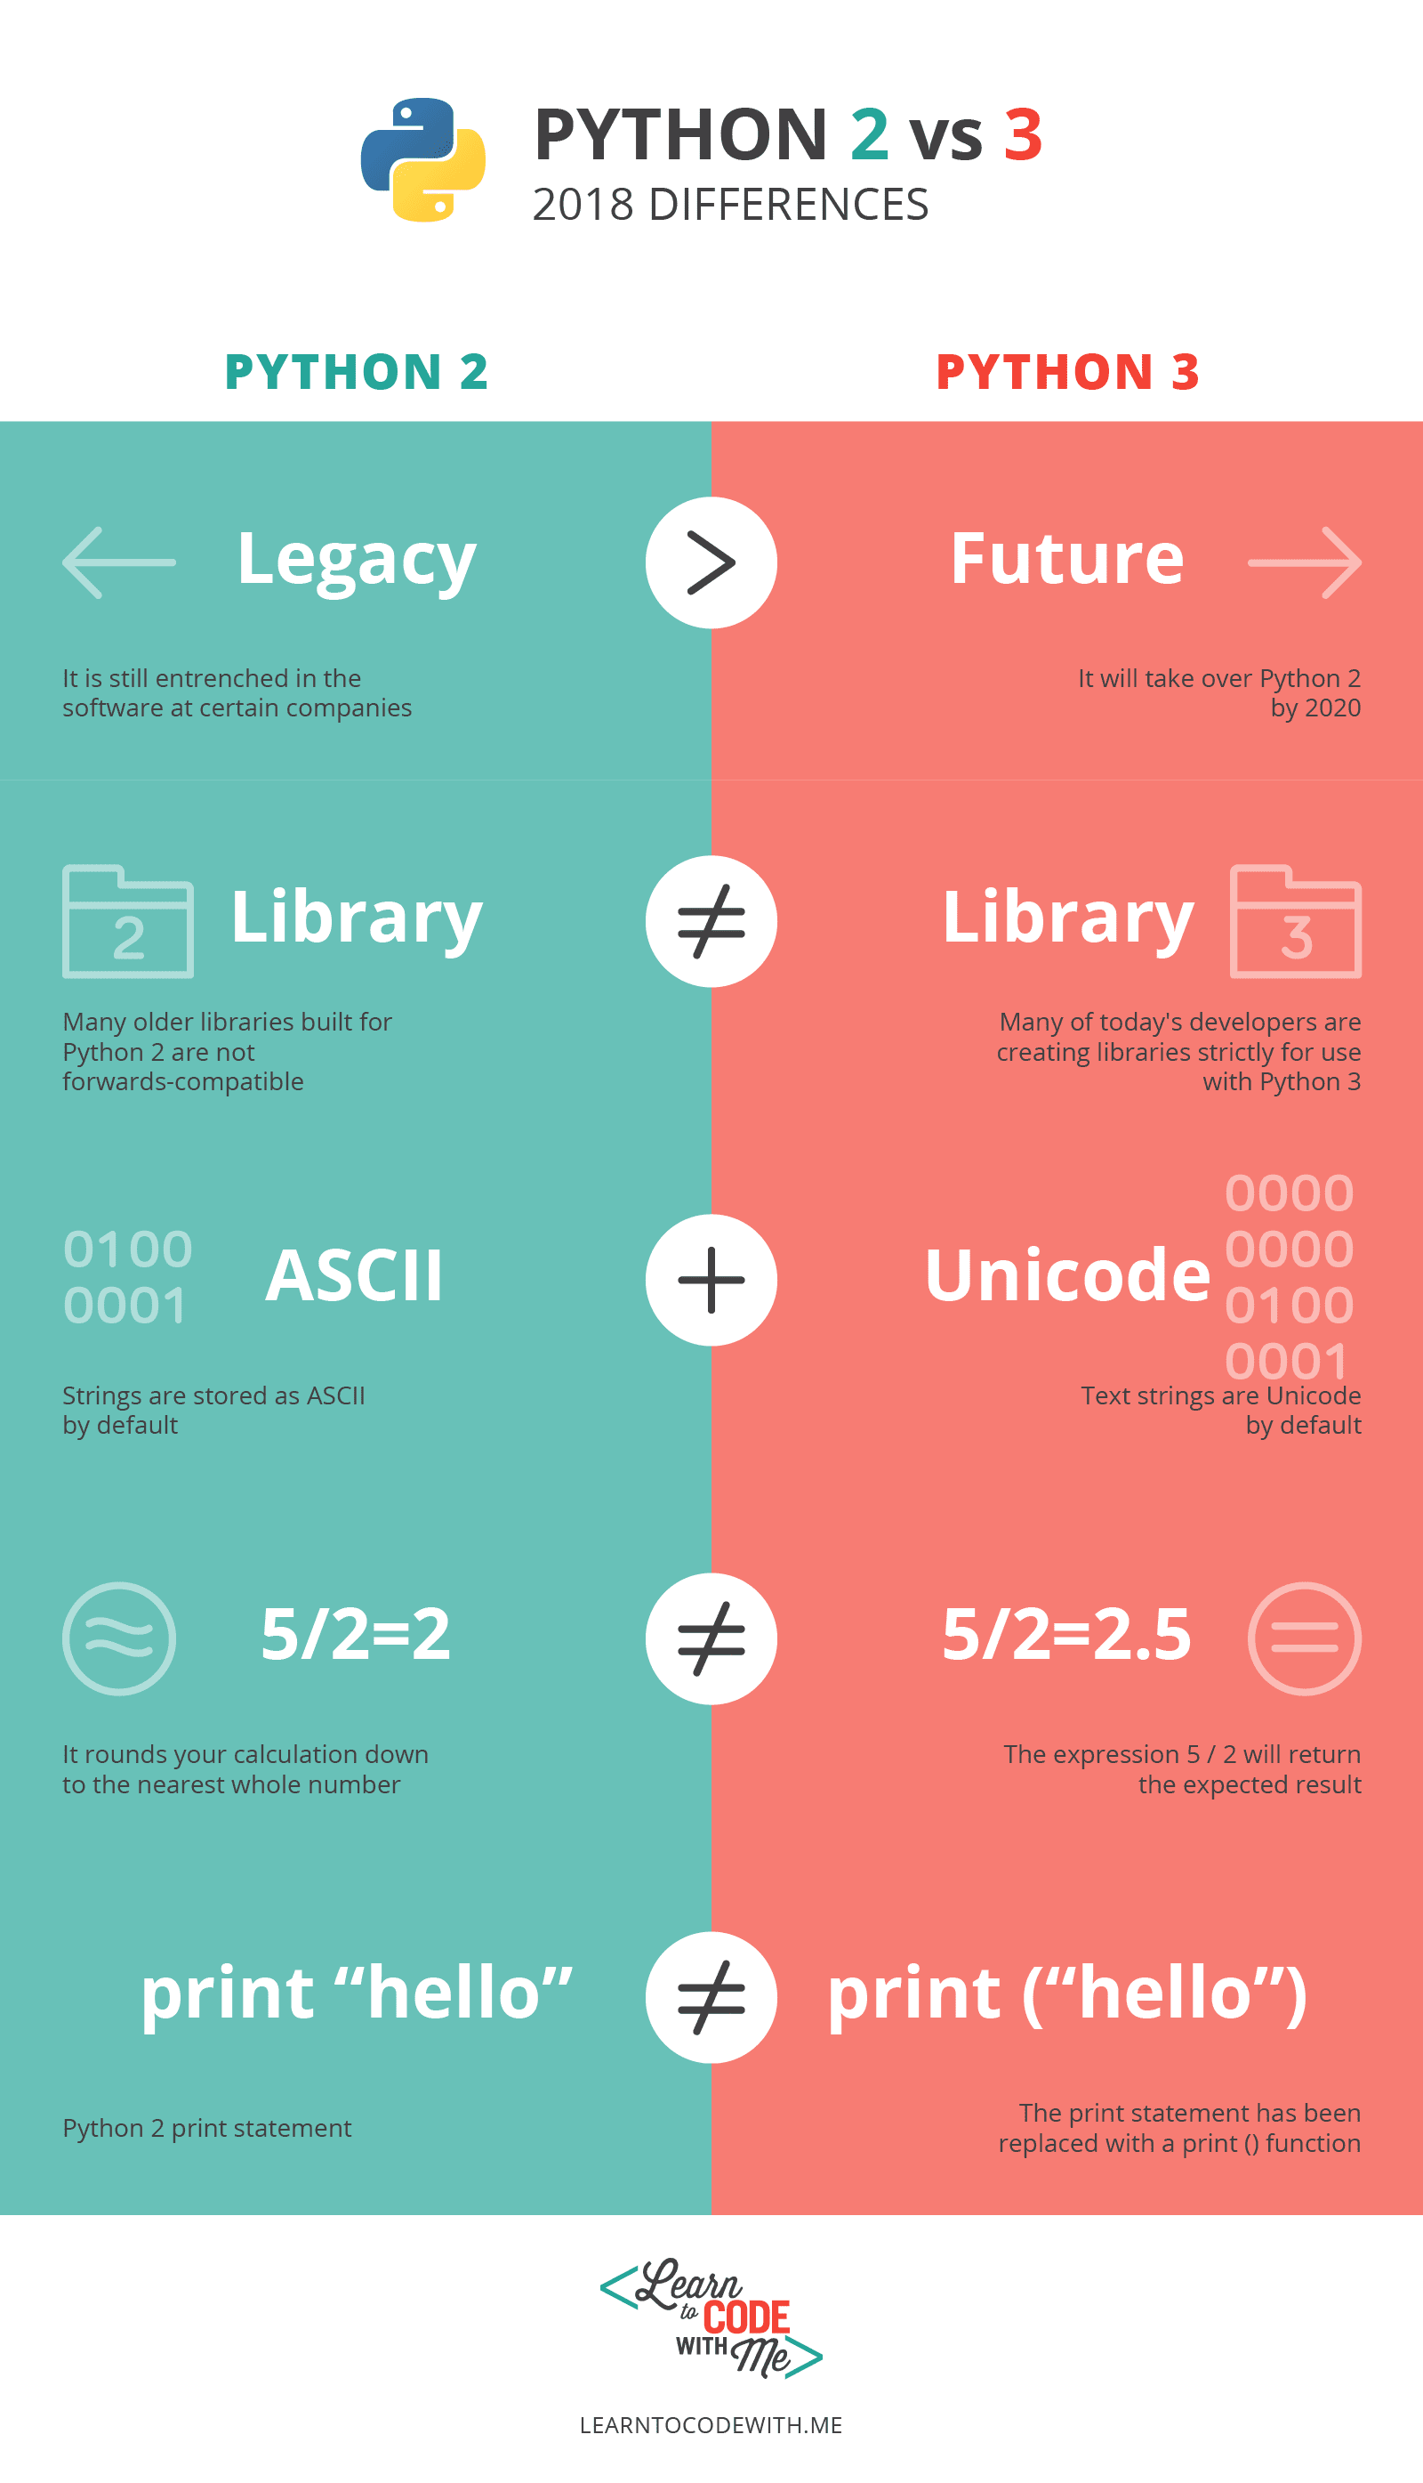
Introduction to Python
Introduction to Python
https://learntocodewith.me/learn/python-2-vs-python-3/

Slide 26
Introduction to Python
Introduction to Python
Start up a console, and on Windows enter the following commands (which assume that Python is installed in the default location)—the console’s output is shown in lightface; what you type is shown in bold:
hello.py
C:\>cd c:\py3eg
C:\py3eg\>c:\python31\python.exe hello.py
#!/usr/bin/env python3
print("Hello", "World!")
$ cd $HOME/py3eg
$ python3 hello.py
In both cases the output should be the same:
Hello World!

Slide 27
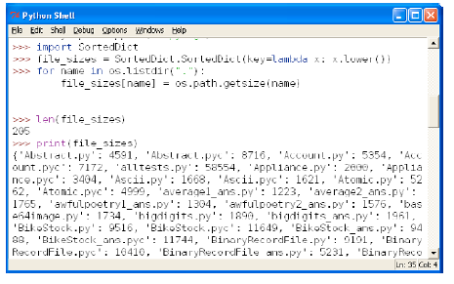
Introduction to Python
Introduction to Python
IDLE provides three key facilities: the ability to enter Python expressions and code and to see the results directly in the Python Shell; a code editor that provides Python-specific color syntax highlighting and indentation support; and a debugger that can be used to step through code to help identify and kill bugs. The Python Shell is especially useful for trying out simple algorithms, snippets of code, and regular expressions, and can also be used as a very powerful and flexible calculator.
hello.py
#!/usr/bin/env python3
print("Hello", "World!")
Figure IDLE’s Python Shell

Slide 28
Introduction to Python
Introduction to Python
Piece #1: Data Types
One fundamental thing that any programming language must be able to do is represent items of data. Python provides several built-in data types, but we will concern ourselves with only two of them for now. Python represents:
integers (positive and negative whole numbers) using the int type, and
strings (sequences of Unicode characters) using the str type.
some examples of integer and string literals:
>>> -973
>>> 210624583337114373395836055367340864637790190801098222508621955072
>>> 0
>>> "Infinitely Demanding"
>>> 'Simon Critchley'
>>> 'positivelyαβφ ÷©'
>>> ''
is 2²¹⁷—the size of Python’s integers is limited only by machine memory, not by a fixed number of bytes.
Traditionally, Python Shells use >>> as their prompt, although this can be
changed.

Slide 29
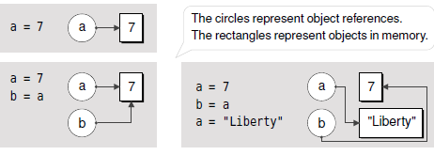
Introduction to Python
Introduction to Python
Piece #2: Object References
Once we have some data types, the next thing we need are variables in which to store them. Python doesn’t have variables as such, but instead has object references. When it comes to immutable objects like ints and strs, there is no discernable difference between a variable and an object reference.
some examples :
The syntax is simply objectReference = value.
>>> x = "blue"
>>> y = "green"
>>> z = x
>>> y = x
Figure Object references and objects

Slide 30
Introduction to Python
Introduction to Python
Piece #3: Collection Data Types
It is often convenient to hold entire collections of data items. Python provides several collection data types that can hold items, including associative arrays and sets. But here we will introduce just two: tuple and list.
Python tuples and lists can be used to hold any number of data items of any data types.
Tuples are immutable, so once they are created we cannot change them.
Lists are mutable, so we can easily insert items and remove items whenever we want.
Tuples are created using commas (,), as these examples show
>>> "Denmark", "Finland", "Norway", "Sweden"
('Denmark', 'Finland', 'Norway', 'Sweden')
>>> "one",
('one',)
>>> ()
Here are some example lists:
>>> [1, 4, 9, 16, 25, 36, 49]
>>> ['alpha', 'bravo', 'charlie', 'delta', 'echo']
>>> ['zebra', 49, -879, 'aardvark', 200]
>>> []

Slide 31
Introduction to Python
Introduction to Python
Piece #3: Collection Data Types
Like everything else in Python, collection data types are objects, so we can nest collection data types inside other collection data types, for example, to create lists of lists, without formality.
In procedural programming we call functions and often pass in data items as arguments.
>>> len(("one",))
1
>>> len([3, 5, 1, 2, "pause", 5])
6
>>> len("automatically")
13

Slide 32
Introduction to Python
Introduction to Python
Piece #4: Logical Operations
One of the fundamental features of any programming language is its logical operations. Python provides four sets of logical operations, and we will review the fundamentals of all of them here.
The Identity Operator
>>> a = ["Retention", 3, None]
>>> b = ["Retention", 3, None]
>>> a is b
False
>>> b = a
>>> a is b
True
>>> a = "Something"
>>> b = None
>>> a is not None, b is None
(True, True)
The most common use case for is is to compare a data item with the built-in
null object, None, which is often used as a place-marking value to signify
“unknown” or “nonexistent”:
The is operator is a binary operator that returns True if its left-hand object reference is referring to the same object as its right-hand object reference.

Slide 33
Introduction to Python
Introduction to Python
Piece #4: Logical Operations
One of the fundamental features of any programming language is its logical operations. Python provides four sets of logical operations, and we will review the fundamentals of all of them here.
Comparison Operators
>>> a = 2
>>> b = 6
>>> a == b
False
>>> a < b
True
>>> a <= b, a != b, a >= b, a > b
(True, True, False, False)
Python provides the standard set of binary comparison operators, with the expected semantics: < less than, <= less than or equal to, == equal to, != not equal to, >= greater than or equal to, and > greater than.
Similarly, strings appear to compare properly too:
>>> a = "many paths"
>>> b = "many paths"
>>> a is b
False
>>> a == b
True

Slide 34
Introduction to Python
Introduction to Python
Piece #4: Logical Operations
One of the fundamental features of any programming language is its logical operations. Python provides four sets of logical operations, and we will review the fundamentals of all of them here.
The Membership Operator
Logical Operators
logical operators: and, or, and not
>>> five = 5
>>> two = 2
>>> zero = 0
>>> five and two
2
>>> two and five
5
>>> five and zero
0
>>> p = (4, "frog", 9, -33, 9, 2)
>>> 2 in p
True
>>> "dog" not in p
True
>>> nought = 0
>>> five or two
5
>>> two or five
2
>>> zero or five
5
>>> zero or nought
0
not x Returns True if x is False, False otherwise
x and y Returns x if x is False, y otherwise
x or y Returns y if x is False, x otherwise
>>> p = (4, "frog", 9, -33, 9, 2)
>>> 2 in p
True
>>> "dog" not in p
True
Both and and or use short-circuit logic and return the operand that determined the result—they do not return a Boolean (unless they actually have Boolean operands).

Slide 35
Introduction to Python
Introduction to Python
Piece #5: Control Flow Statements
Instead of progressing line by line, the flow of control can be diverted by a function or method call or by a control structure, such as a conditional branch or a loop statement. Control is also diverted when an exception is raised.
The general syntax for Python’s if statement is this:
The general syntax for Python’s while statement is this:
if x:
print("x is nonzero")
while boolean_expression:
suite
if boolean_expression1:
suite1
elif boolean_expression2:
suite2
...
elif boolean_expressionN:
suiteN
else:
else_suite
while True:
item = get_next_item()
if not item:
break
process_item(item)
if lines < 1000:
print("small")
elif lines < 10000:
print("medium")
else:
print("large")

Slide 36
Introduction to Python
Introduction to Python
Piece #5: Control Flow Statements
Instead of progressing line by line, the flow of control can be diverted by a function or method call or by a control structure, such as a conditional branch or a loop statement. Control is also diverted when an exception is raised.
The general syntax for Python’s for statement is this:
The general syntax for Python’s try statement (Exception handling) is this:
try:
try_suite
except exception1 as variable1:
exception_suite1
…
except exceptionN as variableN:
exception_suiteN
for variable in iterable:
suite
>>> for country in ["Denmark", "Finland", "Norway", "Sweden"]:
print(country)
s = input("enter an integer: ")
try:
i = int(s)
print("valid integer entered:", i)
except ValueError as err:
print(err)
>>> countries = ["Denmark", "Finland", "Norway", "Sweden"]
>>> for country in countries:
print(country)
3.5
invalid literal for int() with base 10: '3.5'
13
valid integer entered: 13

Slide 37

Introduction to Python
Introduction to Python
Piece #6: Arithmetic Operators
Python provides a full set of arithmetic operators, including binary operators for the four basic mathematical operations:+ addition, - subtraction,* multiplication, and / division. In addition, many Python data types can be used with augmented assignment operators such as += and *=.
When an augmented assignment operator is used on an immutable object (int, str) is that the operation is performed, and an object holding the result is created; and then the target object reference is re-bound to refer to the result object rather than the object it referred to before
And if the original object a was referring to has no more object references referring to it, it will be scheduled for garbage collection.
>>> 5 + 6
11
>>> 3 - 7
-4
>>> 4 * 8
32
>>> a = 5
>>> a
5
>>> a += 8
>>> a
13
>>> 12 / 3
4.0
>>> 3 // 2
1
Figure Augmented assignment of an immutable object

Slide 38
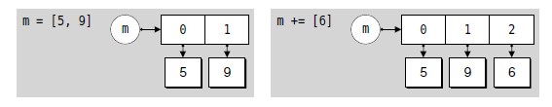
Introduction to Python
Introduction to Python
Piece #6: Arithmetic Operators
Python provides a full set of arithmetic operators, including binary operators for the four basic mathematical operations:+ addition, - subtraction,* multiplication, and / division. In addition, many Python data types can be used with augmented assignment operators such as += and *=.
When an augmented assignment operator is used on an immutable object (int, str) is that the operation is performed, and an object holding the result is created; and then the target object reference is re-bound to refer to the result object rather than the object it referred to before
And if the original object a was referring to has no more object references referring to it, it will be scheduled for garbage collection.
>>> seeds = ["sesame", "sunflower"]
>>> seeds += ["pumpkin"]
>>> seeds
['sesame', 'sunflower', 'pumpkin']
Since lists are mutable, when += is used the original list object is modified, so
no rebinding of seeds is necessary
Figure Augmented assignment of an immutable object
Figure Augmented assignment of a mutable object

Slide 39
Introduction to Python
Introduction to Python
Piece #7: Input/Output
To be able to write genuinely useful programs we must be able to read input—for example, from the user at the console, and from files—and produce output, either to the console or to files.
Python provides the built-in input() function to accept input from the user.
print("Type integers, each followed by Enter; or just Enter to finish")
total = 0
count = 0
while True:
line = input("integer: ")
if line:
try:
number = int(line)
except ValueError as err:
print(err)
continue
total += number
count += 1
else:
break
if count:
print("count =", count, "total =", total, "mean =", total / count)
Type integers, each followed by Enter; or just Enter to finish
number: 12
number: 7
number: 1x
invalid literal for int() with base 10: '1x'
number: 15
number: 5
number:
count = 4 total = 39 mean = 9.75

Slide 40
Introduction to Python
Introduction to Python
Piece #8: Creating and Calling Functions
It is perfectly possible to write programs using the data types and control structures that we have covered in the preceding pieces. However, very often we want to do essentially the same processing repeatedly, but with a small difference, such as a different starting value. Python provides a means of encapsulating suites as functions which can be parameterized by the arguments they are passed.
Here is the general syntax for creating a function:
def get_int(msg):
while True:
try:
i = int(input(msg))
return i
except ValueError as err:
print(err)
def functionName(arguments):
suite
The arguments are optional and multiple arguments must be comma-separated.
Every Python function has a return value; this defaults to None unless we return from the function using the syntax return value, in which case value is returned. The return value can be just one value or a tuple of values.
age = get_int("enter your age: ")

Slide 41
Introduction to Python
Introduction to Python
Piece #8: Creating and Calling Functions
It is perfectly possible to write programs using the data types and control structures that we have covered in the preceding pieces. However, very often we want to do essentially the same processing repeatedly, but with a small difference, such as a different starting value. Python provides a means of encapsulating suites as functions which can be parameterized by the arguments they are passed.
A Python module is just a .py file that contains Python code, such as custom function and class (custom data type) definitions, and sometimes variables. To access the functionality in a module we must import it.
>>> import sys
Once a module has been imported, we can access any functions, classes, or variables that it contains.
>>> print(sys.argv)
>>>import random
>>>x = random.randint(1, 6)
>>>y = random.choice(["apple", "banana", "cherry", "durian"])

Slide 42

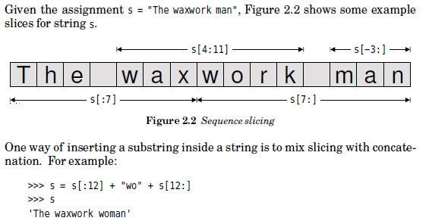
Introduction to Python
Introduction to Python

Slide 43
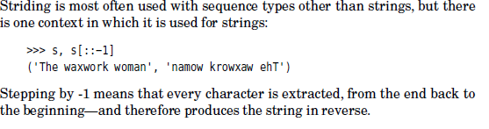
Introduction to Python
Introduction to Python

Slide 44

Introduction to Python
Introduction to Python
Concatenation with +,
appending with +=,
replication with *, and
augmented assignment replication with *=.

Slide 45
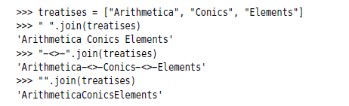
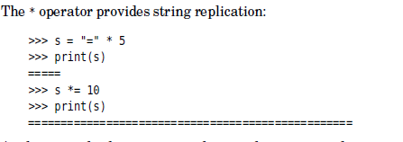
Introduction to Python
Introduction to Python
String Operators and Methods
In cases where we want to concatenate lots of strings the str.join() method offers a better solution.

Slide 46
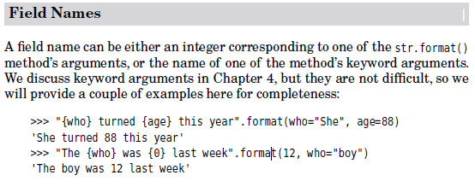
Introduction to Python
Introduction to Python

Slide 47
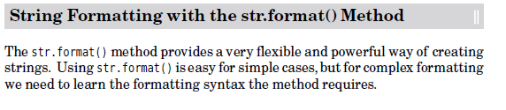

Introduction to Python
Introduction to Python

Slide 48
Introduction to Python
Introduction to Python
Formatted String Literals
Formatted string literals (also called f-strings for short) let you include the value of Python expressions inside a string by prefixing the string with f or F and writing expressions as {expression}.
An optional format specifier can follow the expression. This allows greater control over how the value is formatted. The following example rounds pi to three places after the decimal:
>>>import math
>>>(f'The value of pi is approximately {math.pi:.3f}.')
The value of pi is approximately 3.142.

Slide 49
Introduction to Python
Introduction to Python
The String format() Method
Basic usage of the str.format() method looks like this:
>>>('We are the {} who say "{}!"'.format('knights', 'Ni'))
We are the knights who say "Ni!"
The brackets and characters within them (called format fields) are replaced with the objects passed into the str.format() method. A number in the brackets can be used to refer to the position of the object passed into the str.format() method.
>>>('{0} and {1}'.format('spam', 'eggs'))
spam and eggs
>>> ('{1} and {0}'.format('spam', 'eggs'))
eggs and spam

Slide 50
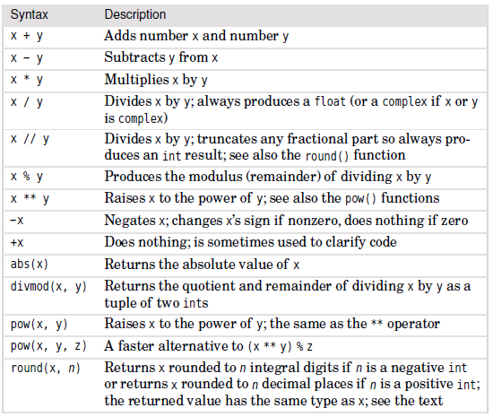
Introduction to Python
Introduction to Python
Integers
Numeric Operators and Functions

Slide 51
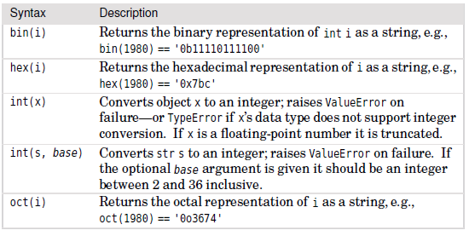
Introduction to Python
Introduction to Python
Integers
Integer Conversion Functions

Slide 52
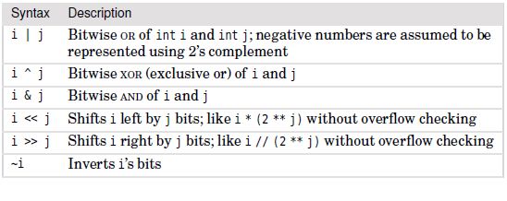
Introduction to Python
Introduction to Python
Integers
Integer Bitwise Operators

Slide 53
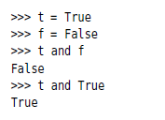
Introduction to Python
Introduction to Python
Booleans

Slide 54
Introduction to Python
Introduction to Python

Slide 55
Introduction to Python
Introduction to Python

Slide 56
Introduction to Python
Introduction to Python

Slide 57
Introduction to Python
Introduction to Python

Slide 58
References
Text Books:
Mark Summerfield, “Programming in Python 3”, 2nd Edition, Pearson Education, 2011.
Harvey M. Deitel, “Python – How to program” , Prentice Hall, 2002
Reference Books:
Michael Dawson, “Python Programming for the Absolute Beginner”, Third Edition, Cengage Learning, 2010.
Mark Lutz, “Learning Python”, 4th Edition, O’Reilly, 2000.
Online MOOC:
https://nptel.ac.in/courses/106/106/106106145/
https://nptel.ac.in/courses/106/106/106106182/

Slide 59
THANK-YOU

